Slide 1
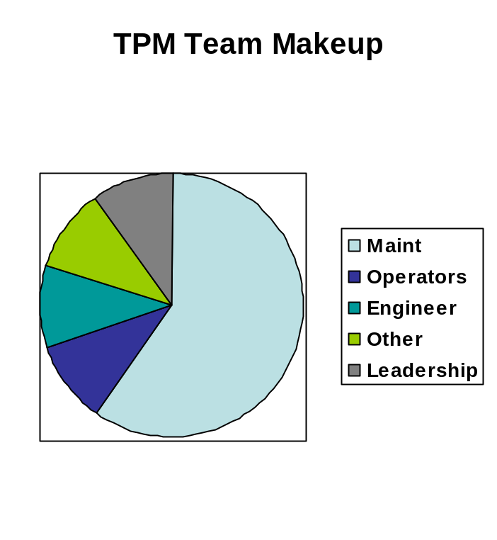
TPM Event Description
The purpose of this event is to create a more efficient workplace by continuously improving the reliability and capabilities of production equipment
In carrying out this event the team members will
  Conduct a THOROUGH CLEANING OF THE EQUIPMENT(5S). This is done to enable a detailed inspection of the equipment
  Assess all items that are in need of repair
  Paint equipment and generally make it look like new
  Repair as much as possible during the event and schedule the remaining items
  Modify the equipment to make it easy for the operator to conduct daily status checks
  Create an instruction set (standard work) that maintains the level of order that was achieved during the event
  Train operators and mechanics in the process

